Slide 1
SAP BTP Build Apps Training
Day 3
Anubhav Oberoy
www.AnubhavTrainings.com
Follow excellence with sheer passion

Slide 2


DISCLAIMER
The training content and delivery of this presentation is confidential, and cannot be recorded, or copied and distributed to any third party, without the written consent of Anubhav Trainings

Slide 3
Agenda – Day 3
01
Build Apps introduction
02
Fiori vs Build Apps
03
Create and Test first Application

Slide 4
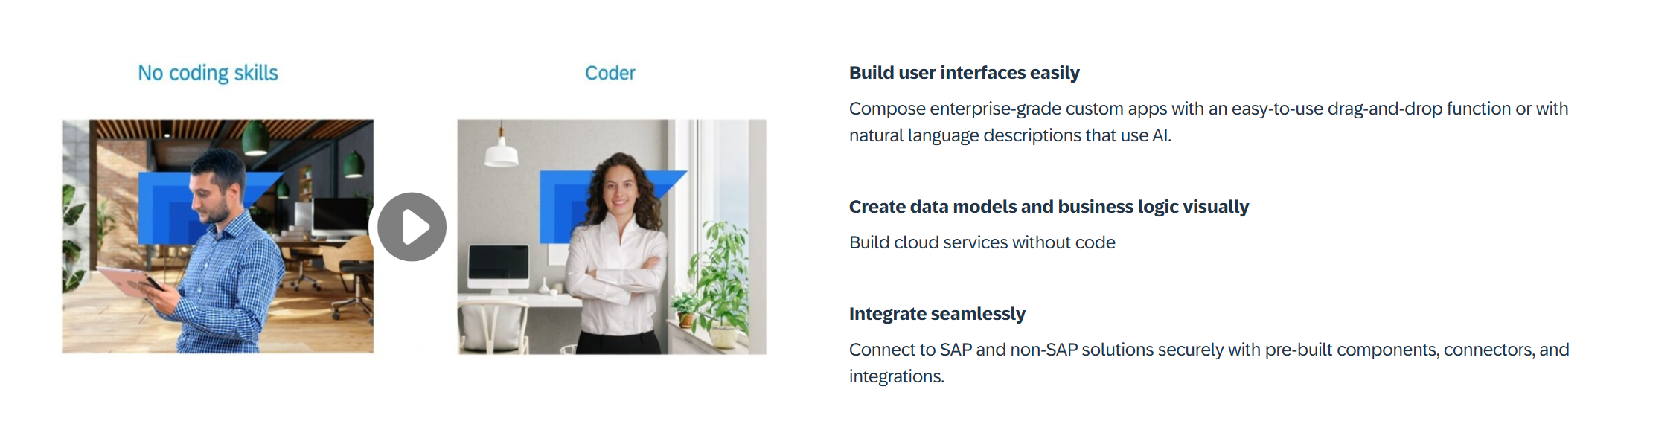
What is Build Apps?
SAP Build Apps is an AI-infused professional application development solution designed for anyone to quickly create apps without code regardless of role or skill level.

Slide 5
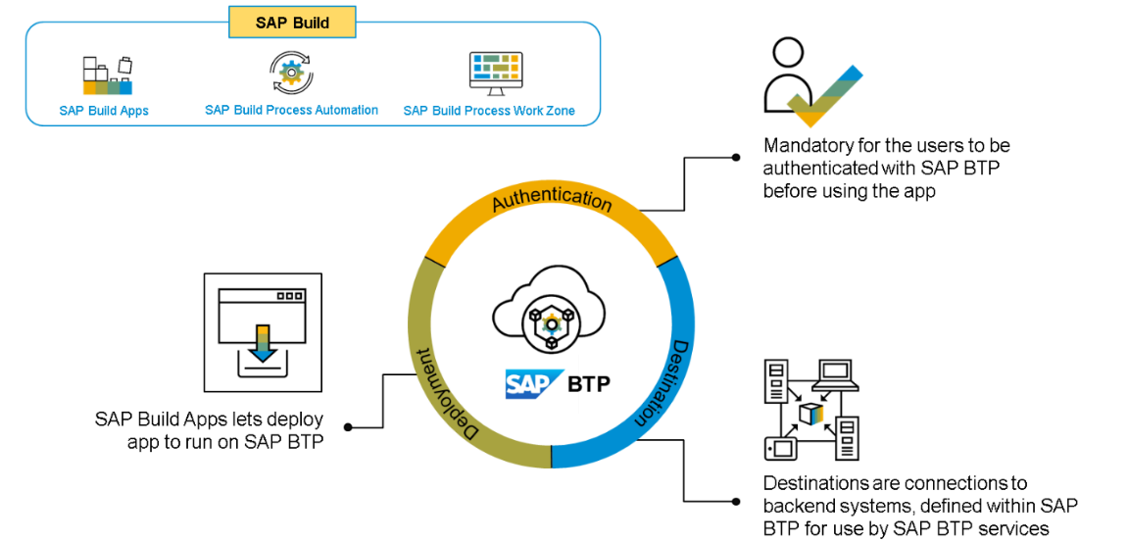
Core Capabilities?
Build Visually – SAP Build Capabilities enable customers to build visually, using drag-and-drop tools and intuitive interfaces. This allows users to quickly and easily design, configure, and deploy applications with no coding. By leveraging the SAP Build capabilities, customers can quickly create rich, interactive applications that streamline business processes, drive greater efficiency, and reduce operational costs. The tools are designed to be easy to use and are backed by a comprehensive library of pre-configured components, integration APIs, and data connectors.
Integrate Seamlessly – SAP Build capabilities help customers integrate their SAP solutions, applications, and systems with each other and with other systems and applications.
Collaborate Effectively – With its feature of seamless integration, SAP Build helps businesses leverage technologies like cloud-based tools with development teams to establish communication protocols like lifecycle management and built-in governance.

Slide 6
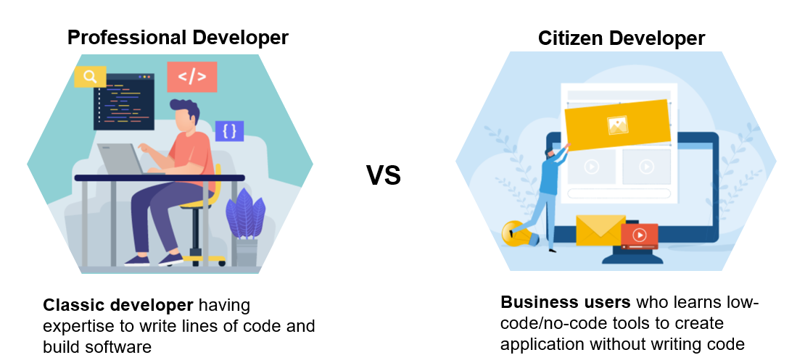
Who is the Build Apps for?

Slide 7
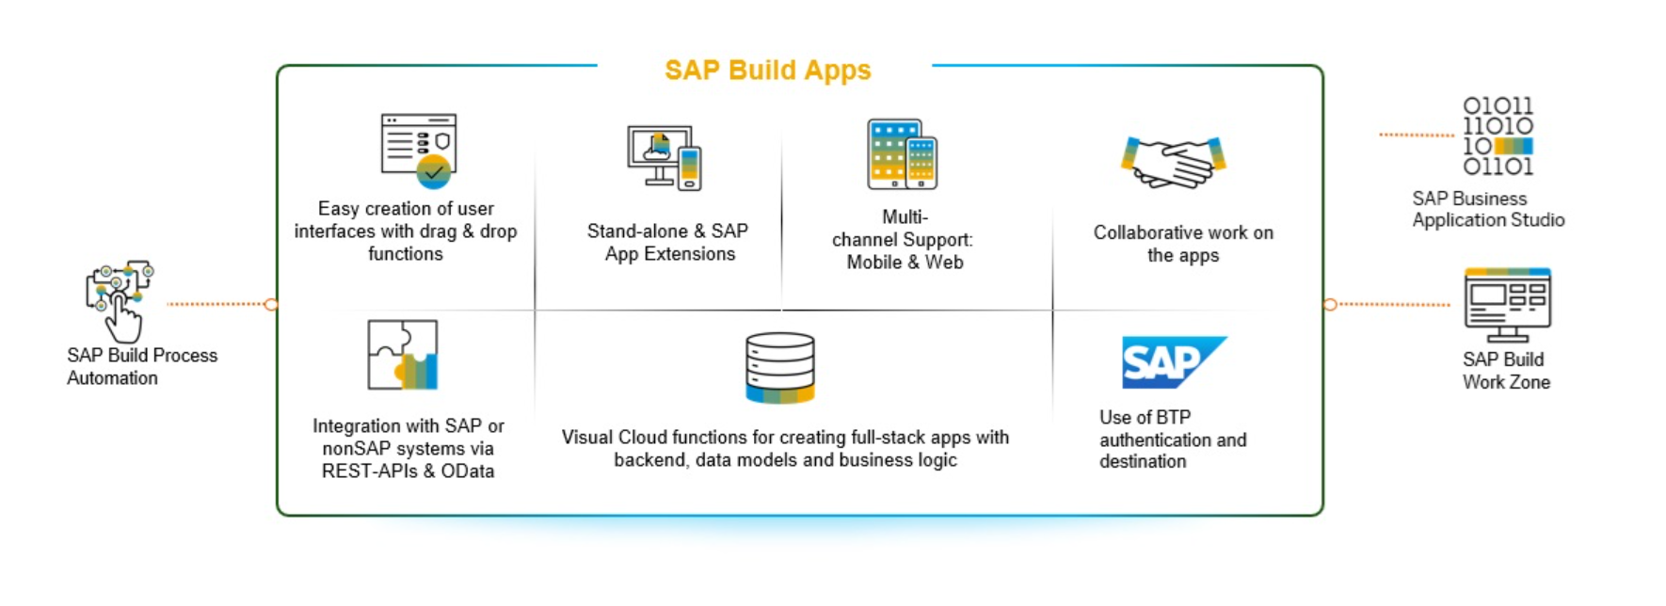
SAP Build Apps – Use Cases

Slide 8
SAP UI5 v/s SAP Build Apps
Aspect | SAP UI5 | SAP Build Apps
Development Approach | Full-code development (JavaScript, HTML, CSS) | Low-code/no-code (drag-and-drop, minimal code)
Target Audience | Frontend developers, UI/UX designers, SAP developers | Business users, citizen developers, IT teams
Customizability | Highly customizable, full control over design and logic | Flexible with limits; customization possible with code
Ease of Use | Requires programming knowledge (JavaScript) | Very user-friendly, no/less programming required
Platform Type | UI framework for building custom web apps, Suitable for both cloud and on-premise apps | Low-code platform for full app development (web, mobile) suitable for cloud and native apps
APK support | Using Cordova plugin | Direct support to extract the APK
UI Components | Advanced, enterprise-grade UI components | Pre-built, basic UI components for rapid development
Integration with SAP Systems | Seamless integration with SAP backend (S/4HANA, Fiori, etc.) | Integrates with SAP and non-SAP systems via APIs
Integration with Third-Party Systems | Typically requires custom development | Easy integration with third-party systems via APIs
Flexibility in Design | Full flexibility for custom designs and behaviors | Limited flexibility compared to full coding, but extensible with logic
Complexity | High, requires technical knowledge and expertise | Low, accessible for non-technical users
Speed of Development | Slower, due to custom coding and in-depth UI design | Faster, thanks to low-code/no-code approach
Cost | High | Less
Use Case | Custom, enterprise-level applications with detailed UI | Rapid prototyping and app development for business needs
Extensibility | Fully extensible with custom code | Extensible with custom code but within a low-code environment
Maintenance | Requires ongoing developer involvement for updates | Easier to maintain, especially for non-technical teams
Learning Curve | Steep learning curve for developers | Low learning curve for non-technical users

Slide 9
Key roles involved in the Business Process
The key roles involved in a business apps can be categorized as below
BuildAppsAdministrator:
This role grants full control over SAP Build Apps applications, including all functionalities and configurations.
BuildAppsDeveloper:
This role is for developers who can create, modify, and deploy applications within SAP Build Apps.
RegistryAdmin:
This role allows users to view and perform any actions on all projects, regardless of project-level authorizations.
RegistryDeveloper:
This role is for developers who can manage projects and registries.

Slide 10
Client Server Model – How web Applications work

Slide 11
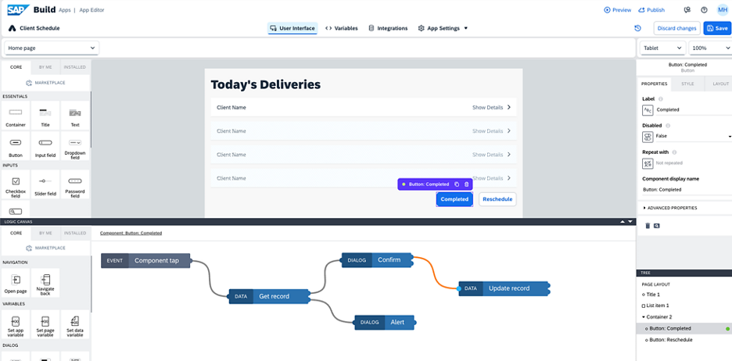
Architecture
<content>

Slide 12
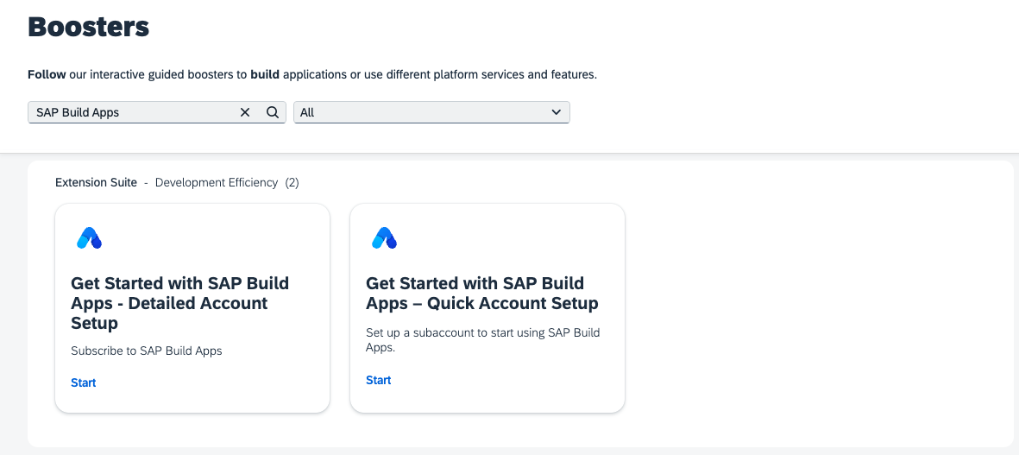
What is Build Apps Booster
To automatically subscribe, navigate to the Boosters tab in your Global account and search for Get Started with SAP Build Apps. At the moment, there are two boosters available: "Detailed Account Setup" and "Quick Account Setup". Choose Quick Account Setup if you're new to the SAP BTP platform or haven't set up a subaccount for SAP Build Apps yet. Detailed Account Setup gives you more control over the setup process and allows you to use an already created subaccount.

Slide 13

Hands-on Setup and overview of Build Apps

Slide 14
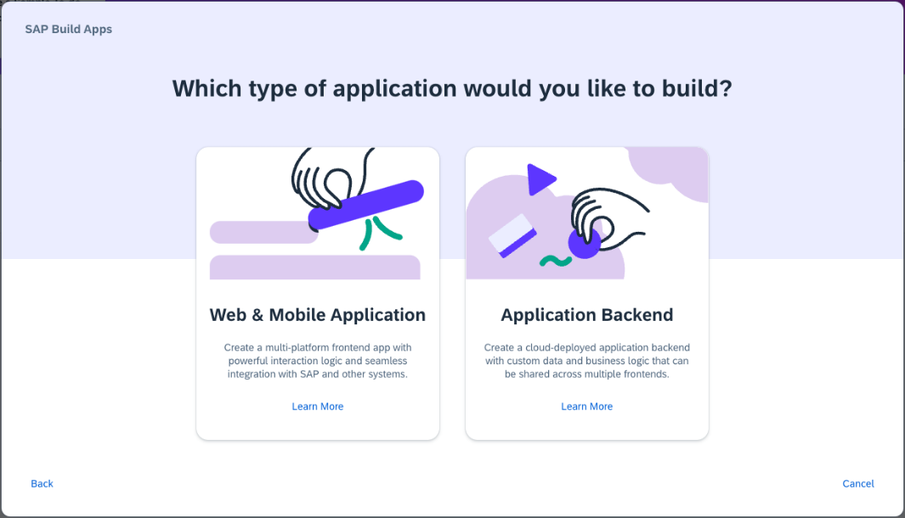
Core Components
Lobby – Centrally view and manage all build apps and business processes.
User Interface – design and develop the pages which includes UI elements such as text, input, radio etc.
Variables – define local and global variables to exchange and manage data of the running app
Integrations – Manage integrations and connections to 3rd party systems and servers such as S/4HANA
Navigation – Manage the side panel and navigation option for burger icon
Authentication – Control the authentication mechanism for allowing secure access for users
Theme – Build and apply custom theme for the application to give branding

Slide 15
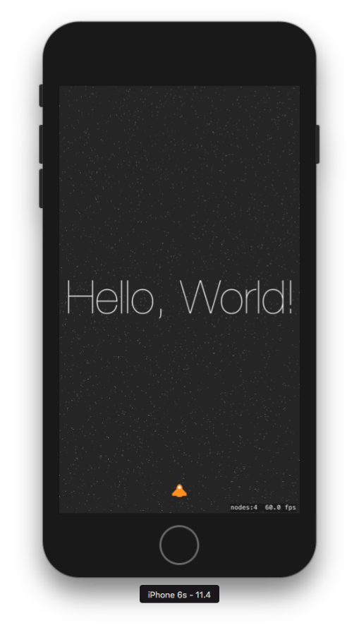
Create your first hello world application

Slide 16
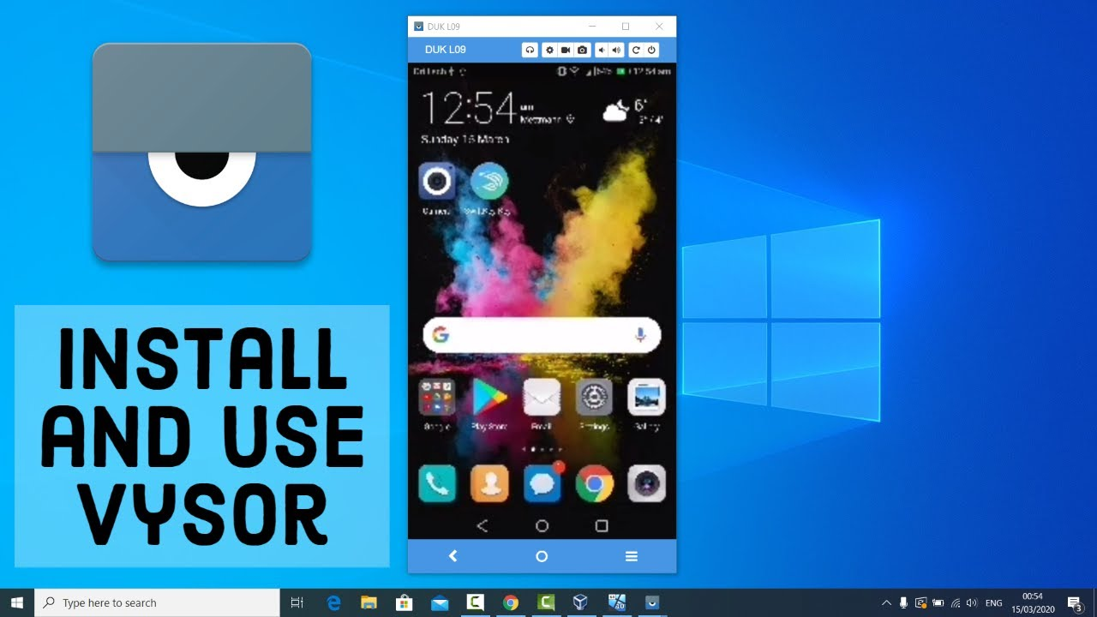
Test your app

Slide 17
Android Developer mode
Open Settings: Access the Settings app on your Android device.
Navigate to About phone: Go to About phone (or About device) within the Settings menu.
Tap Build number: Locate the Build number and rapidly tap it seven times.
Confirm Developer Options: You'll see a message indicating you've enabled Developer Options.
Access Developer Options: The Developer Options menu will now appear in your main Settings menu.

Slide 18

What We Did
Let’s Summarize

Slide 19

www.anubhavtrainings.com
Thank You
End of Day 3

Slide 20


We’re committed to empower you to be
#FutureReady
through powerful training solutions.
We build the workforce of the future.
250+
Corporate Clients
30,000+
Learners Trained
25000+
Learners Placed
FREE WEBINARS
Sign up for free webinars with industry experts every fortnight!
Enroll Now!
Contact us today!
https://anubhavtrainings.com

